Slide 2
Percent of Children Removed with Alcohol or Other Drug Use as a Reason for Removal by Age, 2015
National: 44.9% 31.2%
Note: Estimates based on all children in out of home care at some point during Fiscal Year
Source: AFCARS Data, 2015
Notes:
BLUE BARS – Represent the percentage of all children removed under 1 who were removed with AOD as a reason for removal. All children under 1 removed with AOD as a reason for removal divided by all children removed under 1.
ORANGE BARS – Represent the percentage of all children removed 1 and older who were removed with AOD as a reason for removal. All children 1 and older removed with AOD as a reason for removal divided by all children removed 1 and older.
There are two separate Ns included in this graph as we had to pull the data separately for children under and over age 1. The corresponding N’s are referenced below.
First N= Under age 1; Second N= Age 1 and Older
Alaska = 446; 1766
Alabama = 642; 2045
Arkansas = 774; 2444
Arizona = 1893; 5307
California = 2691; 6853
Colorado = 878; 2667
Connecticut = 504; 1296
District of Columbia = 46; 141
Delaware = 29; 29
Florida = 4021; 10593
Georgia = 1264; 3648
Hawaii = 195; 430
Iowa = 779; 3343
Idaho = 211; 628
Illinois = 654; 1230
Indiana = 2553; 9146
Kansas = 846; 3101
Kentucky = 813; 2170
Louisiana = 135; 308
Massachusetts = 1306; 2999
Maryland = 490; 1054
Maine = 360; 969
Michigan = 1698; 4132
Minnesota = 1016; 3167
Missouri = 1934; 5911
Mississippi = 611; 2022
Montana = 366; 1077
North Carolina = 1169; 3810
North Dakota = 182; 641
Nebraska = 435; 1379
New Hampshire = 22; 34
New Jersey = 1303; 2875
New Mexico = 387; 1494
Nevada = 436; 947
New York = 1838; 3845
Ohio = 1643; 3882
Oklahoma = 2031; 4851
Oregon = 1262; 4562
Pennsylvania = 2354; 10160
Rhode Island = 259; 487
South Carolina = 316; 854
South Dakota = 161; 721
Tennessee = 1030; 3029
Texas = 6368; 20561
Utah = 518; 2053
Virginia = 371; 1401
Vermont = 104; 342
Washington = 2125; 3903
Wisconsin = 556; 1619
West Virginia = 750; 2324
Wyoming = 114; 617
Total US = 53030; 155523

Slide 3
Family Drug Treatment Court Movement
High prevalence AOD + lack treatment completion + poor outcomes = FDTC emergence
First FDTC started in Reno, Nevada in 1995
Similar to Adult Drug Treatment Courts but uniquely family-oriented and less punitive (2014-25th Anniversary of the first Drug Treatment Courts)
Approximately 360 FDTC in the U.S.
Milwaukee County FDTC is the first in WI
Pilot began in April 2011
Six more counties developing FDTCs

Slide 4
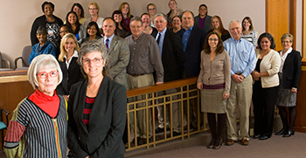
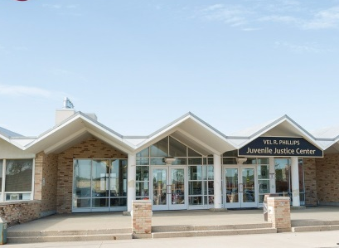
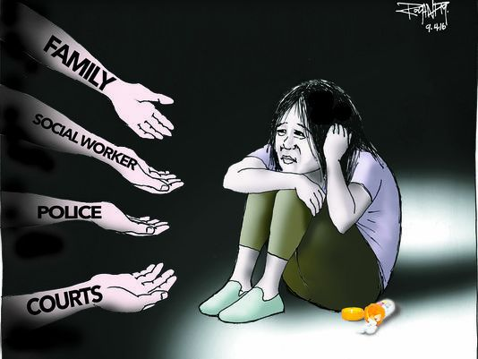
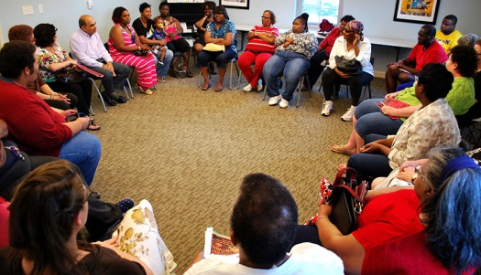
Problem-Solving Courts in Child Welfare
Judiciary & Child Welfare
Family Drug Treatment Court
Team
AODA & Mental Health Expertise
Collaborative, Trauma-Informed Approach

Slide 5
The FDTC Mission
Through collaboration, and with accountability and enhanced access to treatment services, the Family Drug Treatment Court improves the safety, well-being and permanence of children, supports the recovery of their parents from alcohol and drug dependence, and enhances the functioning of the family.

Slide 6
How does FDTC work?
Voluntary Program that successfully addresses parental substance use disorders
Participants commit to 4 Phase Program
Family-centered clinical and recovery support coordinator services
Team approach
FDTC Team, including Judge, conducts weekly reviews of each participant
Frequent, random, observed drug tests

Slide 7
Opiate use, primarily heroin, is the leading type of addiction.
Addictive substance | Primary drug of choice | Any use of drug
Any opiates | 54.9% | 67.4%
Cocaine/crack | 19.6% | 44.6%
Alcohol | 18.5% | 34.8%
Marijuana | 6.5% | 29.3%

Slide 8
Quick Connection to Substance Abuse Treatment and Services
“You may be free of me now, but I could always put you in restriction. All it takes is “one more time” and I’ll have you on that mission! I’ll pretend to be your friend even though I’m faker than fiction! You need to always be aware of this because I am YOUR ADDICTION!!!
--- Rebekkah Webb, FDTC Participant
Most participants are served through Milwaukee County’s WIser Choice program. Others have private insurance.
Treatment services
Recovery support services align with comprehensive, trauma-informed services:
Peer support
Mental health services
Education/employment
Housing assistance
The FDTC Team coordinates treatment, recovery and child welfare services to achieve agreed-upon goals.

Slide 9
4 Phases of FDTC
Phase 1: Support the choice to become a drug-free parent and start living drug-free. | Phase 2: Challenge the parent to confront the reasons for addiction.
Phase 3: Support the transition of parent’s behavior into self-sufficiency for the family. | Phase 4: Improve the capacity to safely parent children with or without ongoing supervision by BMCW.

Slide 10
Why FDTC Works
FDTC Best Practices | Milwaukee County FDTC
Focus on services to child and parents | √
Decrease time to treatment entry | √
Frequent counseling sessions | √
Longer time in treatment | √
Relationship with judge | √
Frequent random and observed urine drug testing | √
Treatment representative attends staffings | √
Judge attend staffings | √
Results of program evaluation lead to drug court modifications | √
Program caseload is less than 125 | √
S.M. Carey, J. Mackin, Judge D. Burleson, K. Walker, “Family Drug Treatment Court Costs and Best Practices: What do we know so far?” NPC Research, NADCP Annual Conference 2013

Slide 11
National Outcomes
FDTC approach is a winning one:
Improving treatment engagement and completion
Reducing length of time children spend in foster care
Increasing the rate and speed of reunification
Reducing arrests
Saving system resources

Slide 12
Is permanency being achieved?
*Parents who were eligible for participation in FDTC but chose not to enter
Statistics as of 2016

Slide 13
FDTC OUTCOMES
271 participants served and 524 children served
38 current active participants
46 successful completions – graduates and/or reunifications
18 babies born healthy and clean from illegal substances to active participants and graduates
2 graduates trained as certified peer mentors
2.5 times more likely to be reunified - children of FDTC participants were 2.5 times more likely to be reunified with their parents than children of parents who were eligible for FDTC but did not participate (comparison group)
50% more likely to remain in out of home care - children of FDTC participants were 50% less likely to remain in OOHC without a permanent placement after 12 months than children of the comparison group
55% of the children were reunified with their FDTC participant parents who had completed at least phase 2, or approximately 5 months in the program, while only 12% of children of the comparison group were reunified (May 2016).
3 of the 46 re-entered the child welfare system

Slide 14
Stakeholders Comments
94% of team members would continue to participate in FDTC if given the choice
56% of team members have been participating in FDTC for two or more years
Team members believe there is more information sharing and communication in FDTC cases and the collaboration between professionals is a major strength of the program

Slide 15
Funding Sources
2011-2015-Office of Juvenile Justice and Delinquency Prevention (OJJDP) Family Treatment Court Implementation Grant
2014-present Department of Children and Families provides funding for the Family Drug Treatment Court and the Healthy Infant Court
2017-2019-Prevention and Family Recovery Initiative from the Doris Duke Foundation, the Duke Endowment and Children and Family Futures
2017-2022-Behavioral Health Division received the Substance Abuse and Mental Health Service Administration (SAMHSA) Grant to Enhance Substance Abuse Treatment Services in Family Drug Treatment Courts

Slide 16
Healthy Babies! There have 18 babies born clean of all substances for active participants and graduates.

